Slide 1
Announcement
HW 1 is on iLearn and it is due at 4PM on Monday 10/23. Only PDF file is accepted!
Coding Assignment 4 is extended to Wednesday
Notes:
Jetlag

Slide 2

Last Time
CPU-bound program and I/O-bound program
Preemptive scheduling and nonpreemptive scheduling
First-Come First-Served Scheduling (FCFS)
Shortest-Job-First Scheduling (SJF)
Shortest-Remaining-Time-First

Slide 3

CSC415 Operating System Principles
CPU Scheduling
Professor Hao Yue
Fall 2017

Slide 4

Outline
Introduction
Scheduling Algorithms
Multi-Processor Scheduling
Real-Time CPU Scheduling

Slide 5
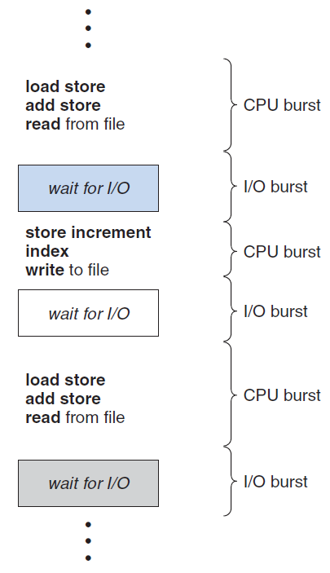
Introduction
Multiprogramming can have some process running at all times, to maximize CPU utilization
CPU-I/O burst cycle: Process execution consists of a cycle of CPU execution and I/O wait
The distribution of CPU bursts is of main concern
A CPU-bound program might have several long CPU bursts
A I/O-bound program typically has many short CPU bursts

Slide 6
CPU Scheduler
Short-term scheduler (CPU scheduler) selects one of the processes in the ready queue and allocates CPU to it, whenever the CPU becomes idle
CPU-scheduling might occur under the following four circumstances
Process switches from the running state to the waiting state
Process terminates
Process switches from the running state to the ready state
Process switches from the waiting state to the ready state
Nonpreemptive scheduling: scheduling happens only under circumstances 1 and 2
Preemptive scheduling: scheduling happens under the four circumstances

Slide 7
Scheduling Criteria
There are many criteria for comparing CPU-scheduling algorithms
CPU utilization
Throughput: the number of processes that are completed per time unit
Turnaround time: the interval from the time of submission of a process to the time of completion
Waiting time: total amount of time spent waiting in the ready queue
Response time: the time from the submission of a request until the first response is produced

Slide 8
Scheduling Algorithms
Problem: which of the processes in the ready queue is to be allocated CPU?
First-Come First-Served Scheduling (FCFS)
Process that requests the CPU first is allocated the CPU first
The average waiting time under FCFS is often long
Example: three processes arrive in the order P₁, P₂, P₃ at time 0
Process
P₁
P₂
P₃
Burst Time
24
3
3

Slide 9
FCFS
Gantt Chart: a bar chart that illustrate a particular schedule, including the start and finish times of each process
Waiting time: P₁=0, P₂=24, P₃=27
Average waiting time: (0+24+27)/3=17

Slide 10
FCFS
Consider the case where the processes arrive in the order P₂, P₃, P₁
Average waiting time: (6+0+3)/3=3
Convoy effect: all the other process wait for the one big process to get off the CPU
FCFS is nonpreemptive

Slide 11
Shortest-Job-First Scheduling
Shortest-Job-First scheduling (SJF)
Associate with each process the length of its next CPU burst
CPU is allocated to the process with the smallest next CPU burst
FCFS scheduling is used to break the tie
SJF is optimal in terms of average waiting time for a given set of processes
Hardness: it is impossible to know the length of the next CPU burst
In practice, estimate the length of the next CPU burst based on previous CPU bursts and approximate SJF scheduling

Slide 12
Shortest-Job-First Scheduling
Example:
Gantt Chart
Average waiting time: (3+16+9+0)/4=7
Process
P₁
P₂
P₃
P₄
Burst Time
6
8
7
3

Slide 13
Shortest-Remaining-Time-First
SJF can be preemptive or nonpreemptive
Example: a new process arrives at the ready queue while a process is still executing. The next CPU burst of the new process is shorter than what is left of the executing process
Nonpreemptive SJF: the currently running process finishes its CPU burst
Preemptive SJF: preempt the currently running process
Preemptive SJF is also called shortest-remaining-time-first scheduling

Slide 14
Shortest-Remaining-Time-First
Example:
Gantt Chart
Average waiting time: [(10-1)+(1-1)+(17-2)+(5-3)]/4=6.5
Process
P₁
P₂
P₃
P₄
Arrival Time
0
1
2
3
Burst Time
8
4
9
5

Slide 15
Priority Scheduling
Priority scheduling
Associate with each process a priority
CPU is allocated to the process with the highest priority
FCFS scheduling is used to break the tie
SJF is a special case of priority scheduling algorithms, where the priority is the inverse of the next CPU burst
Priority scheduling can be either preemptive or nonpreemptive
Preemptive priority scheduling algorithm will preempt the CPU if the priority of a newly arrived process is higher than that of the currently running process

Slide 16
Priority Scheduling
Example: five processes arrive in the order P₁, P₂, …, P₅ at time 0
Average waiting time: (6+0+16+18+1]/5=8.2
Process
P₁
P₂
P₃
P₄
P₅
Burst Time
10
1
2
1
5
Priority
3
1
4
5
2

Slide 17
Priority Scheduling
Problem: Starvation
Low-priority processes may wait for quite a long time or never execute
Solution: Aging
Increase the priority of processes that wait in the system for a long time

Slide 18
Round-Robin Scheduling
Round-Robin scheduling (RR)
CPU scheduler goes around the ready queue and allocates CPU to each process for one time quantum
If the CPU burst is less than 1 time quantum, the process releases the CPU and the scheduler proceeds to the next process
If the CPU burst is longer than 1 time quantum, when the timer goes off, the process is moved to the tail of the ready queue and the CPU scheduler then selects the next process
RR is preemptive
Performance of RR
When the size of time quantum is extremely large, RR=FCFS
When the size of time quantum is extremely small, high overhead due to context switches

Slide 19
Round-Robin Scheduling
Example: use a time quantum of 4
Average waiting time: [(10-4)+4+7]/3=5.66
Process
P₁
P₂
P₃
Burst Time
24
3
3

Slide 20
Multilevel Queue Scheduling
Multilevel Queue scheduling
Ready queue is partitioned into separate queues, e.g., a queue of foreground processes and a queue of background processes
Processes are permanently assigned to one queue
Each queue has its own scheduling algorithm
Scheduling must be done among the queues
Fixed-priority preemptive scheduling: high-priority queues preempt low-priority queues (starvation)
Time-slice scheduling: each queue obtains a certain portion of CPU time, which it can schedule among its processes

Slide 21
Multiple-Processor Scheduling
CPU scheduling in a system with multiple identical processors
Asymmetric multiprocessing
Only one processor accesses system data structure, make scheduling decision, and perform other system activities
Other processors run user code
Symmetric multiprocessing (SMP)
Each processor is self-scheduling
Processors may share the same ready queue, or each other them has its private queue of ready processes

Slide 22
Multiple-Processor Scheduling
Processor affinity
Avoid migration of processes from one processor to another; try to keep them running on the same processor
Load Balancing attempts to keep the workload evenly distributed across all processors in an SMP system
Push migration: periodically check the load on each processor, and evenly distribute the load by moving processes from overloaded to less-busy processors
Pull migration: idle processor pulls a waiting task from a busy processor
Load balancing often counteracts the benefits of processor affinity
Notes:
populate

Slide 23
Real-Time Scheduling
Real-time systems
Soft real-time systems: no guarantee as to when a critical real-time process is scheduled
Hard real-time systems: a task must be served by deadline
Priority-based scheduling
Assign real-time processes the highest priority; real-time processes can preempt other lower-priority processes
Preemptive, priority-based scheduler only works for soft real-time systems
Also need to guarantee real-time tasks are served before deadline in hard real-time systems

Slide 24
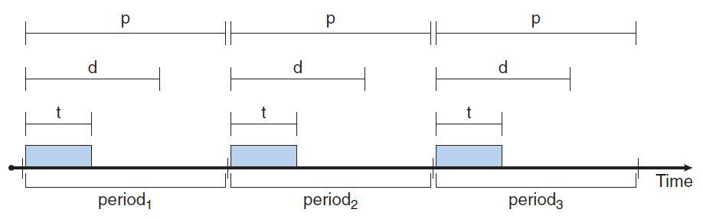
Priority-based Scheduling
New characteristics of the processes
Processes are periodic, meaning they require CPU at constant intervals (periods)
Processing time t, deadline d, and period p, where 0 ≤ t ≤ d ≤ p

Slide 25
Rate-Monotonic Scheduling
Rate-Monotonic scheduling
Each periodic task is assigned a priority inversely based on its period
Higher-priority processes can preempt lower-priority running processes
Rate-Monotonic scheduling is considered as optimal in that
If a set of processes cannot be scheduled by this algorithm, they cannot be scheduled by any other algorithm that assigns static priorities

Slide 26
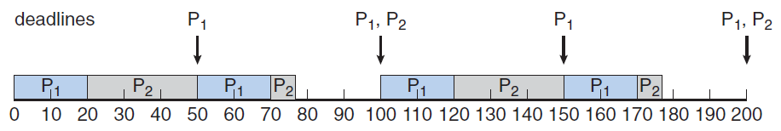
Rate-Monotonic Scheduling
Example: two processes P₁ and P₂
Period: p₁=50, p₂=100
Processing time: t₁=20, t₂=35
Deadline: the start of next period

Slide 27
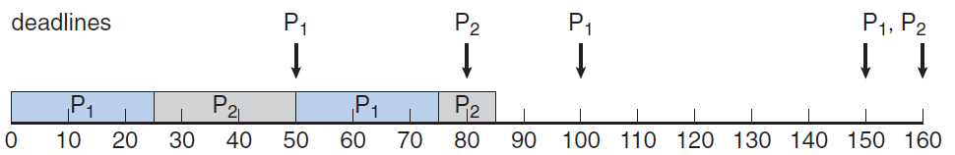
Rate-Monotonic Scheduling
Example of scheduling failure
Processes: P₁ and P₂
Period: p₁=50, p₂=80
Processing time: t₁=25, t₂=35
Deadline: the start of next period

Slide 28
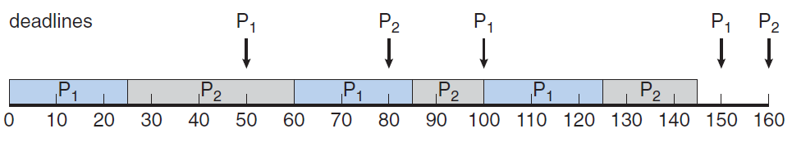
Earliest-Deadline-First Scheduling
Earliest-Deadline-First scheduling
Dynamically assign priorities according to deadline
The earlier the deadline, the higher the priority
Example where Rate-Monotonic fails
Processes: P₁ and P₂
Period: p₁=50, p₂=80
Processing time: t₁=25, t₂=35
Deadline: the start of next period

